Slide 2
PMS Study Results
vakgroep < ... >
onderzoeksgroep < ... >
Mitchel Kappens &
Notes:
Hello everyone! Today Mitchel and I are presenting you the first results of the data analysis of the PMS study

Slide 3
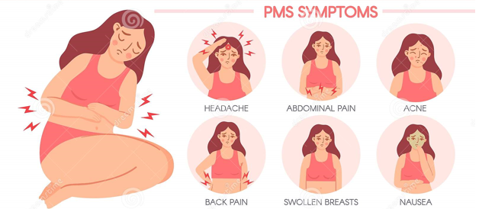
PMS
Mood swings
Anxiety
Tiredness
diarrhea
Bloating
Appetite
Sex drive
…
Notes:
Let me first introduce you to what this study is about.
PMS or Premenstrual Syndrome, is a disorder exclusive to people who have their periods. People who have PMS get a range of symptoms such as mood swings, anxiety, tiredness, sleep problems, abdominal pain and bloating, tender breasts, headaches, spotty skin and changes in appetite and sex drive, and lower serotonin levels. The etiology and symptoms of PMS and depression have been linked together as well.

Slide 4
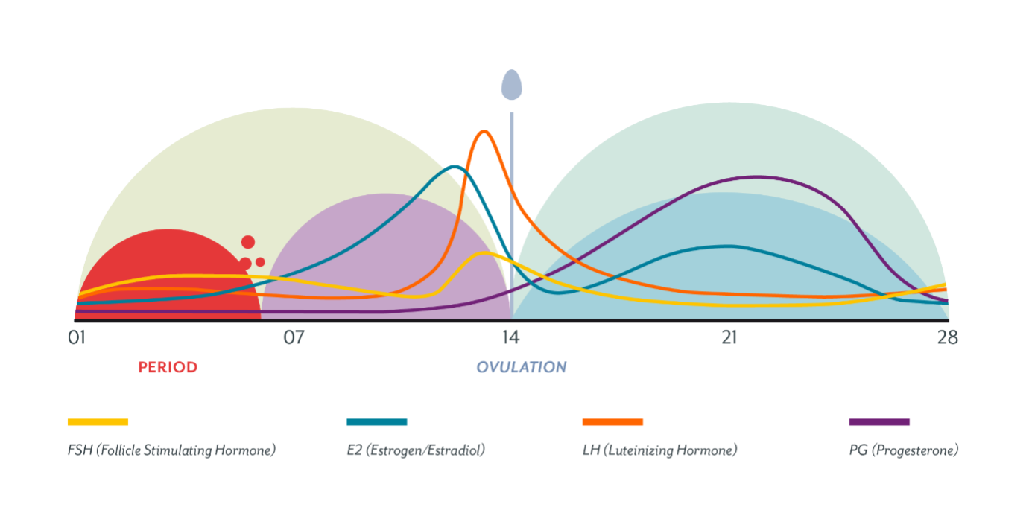
Notes:
As the name suggests, this happens before menstruation, during the luteal phase. Symptoms disappear 1-2 days into menstruations.

Slide 5
PMDD
Premenstrual Dysphoric Disorder
Severe PMS
75%: some symptoms
20-30%: moderate to severe
5-8%: PMDD
Notes:
PMDD, or Premenstrual Dysphoric Disorder has been added to the DSM recently, this is a more severe version of PMS.

Slide 6
groups
Screening
No PMS, PMS and PMDD
=> no PMS & PMS
Notes:
We did some screening on sex, age and such as well as a screening for premenstrual symptoms. This gave us 3 groups: low and high PMS and PMDD. Because we cannot give an official PMDD diagnosis we grouped these participants together with the high participants. This gives us two groups: noPMS and PMS.

Slide 7
Testmoments
TestMoment 1 (follicular)
TestMoment 2 (luteal/premenstrual)
Questionnaires, rate pictures + webcam
Notes:
We then tested the participants twice, based on their cycle. Each time they had to fill in some questionnaires, judge pictures on valence and arousal and were filmed through their webcam for analysis of their emotional expressions.

Slide 8
Questions
PMS vs no PMS
During follicular and luteal(premenstrual) phase cycle:
- Higher stress/rumination?
- Valence & arousal pictures
- Emotional expressions
Notes:
In this study, the question was wether or not people with PMS have higher stress, more rumination and more negative responses than people without PMS, as well as if there is a difference depending on wether we measure this during the premenstrual or luteal phase or during the follicular phase. The follicular phase is the phase after menstruation and before ovulation.

Slide 9
Stress and Rumination

Slide 10
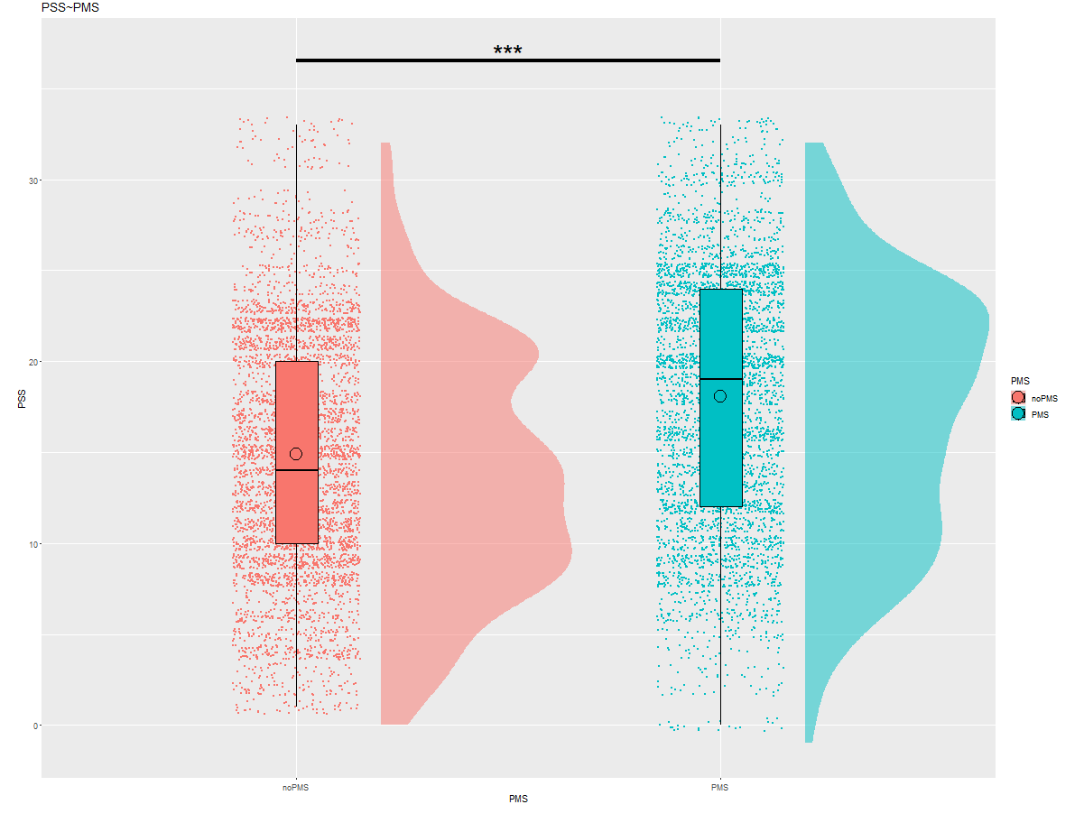
PSS
Perceived Stress
Scale
PMS > no PMS
Notes:
PSS stands for Perceived Stress Scale. This scale measured stress at the two time points.
We first fitted several moments and took the one with the lowest AIC, meaning the model with the best fit to the data, and then did anova and contrasts of means. When we look at PSS we can see a significant effect (with an alpha of 0.05) of PMS,

Slide 11
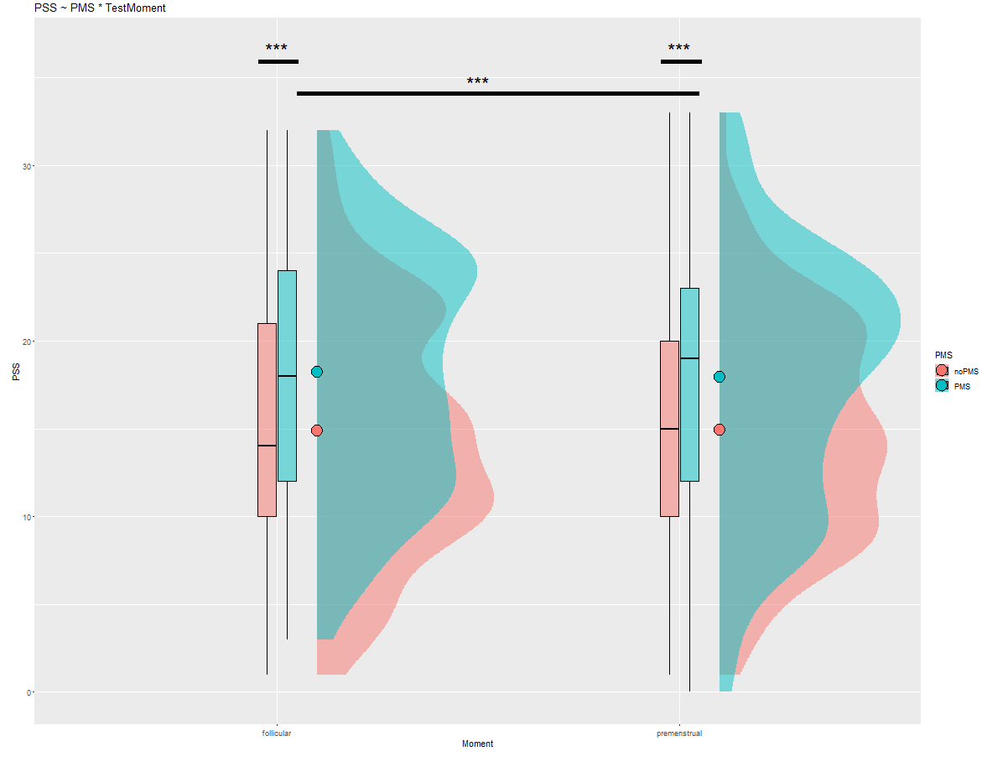
PMS follicular <
PMS premenstrual
Notes:
even when we control for Testmoment.
We also see a significant difference between PMS in follicular and in premenstrual phase, with the people with PMS having higher stress scores in the premenstrual phase, which is when they would be having their PMS symptoms

Slide 12
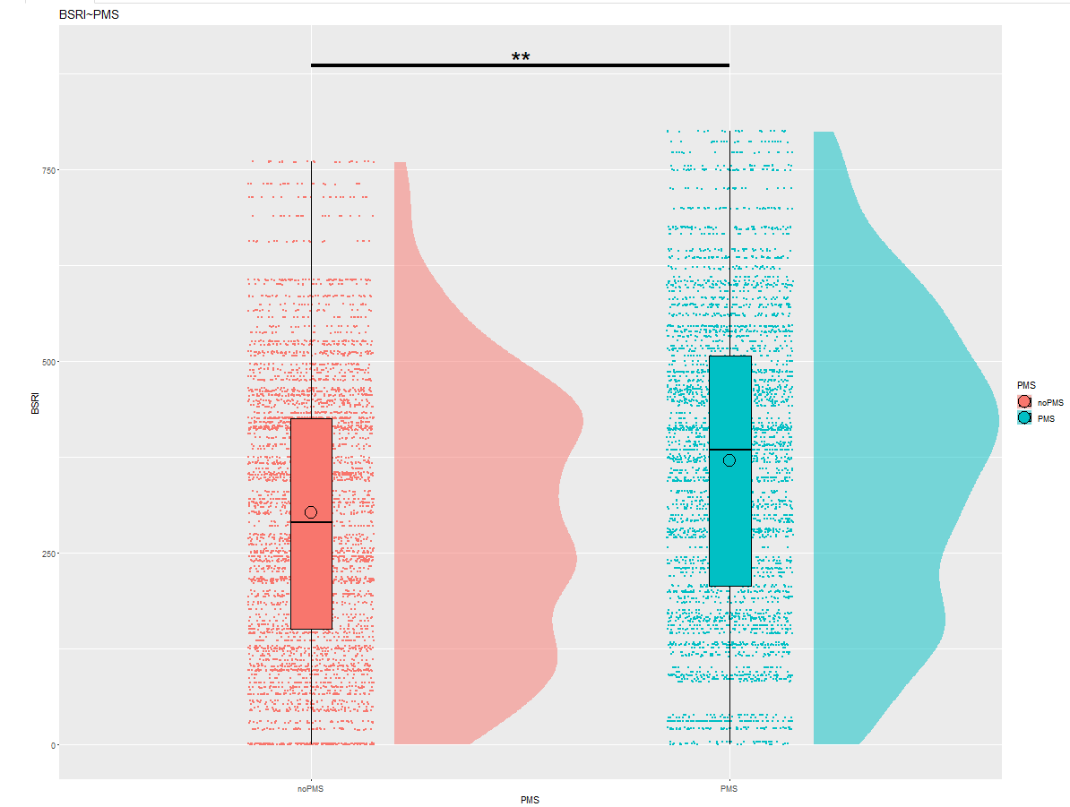
BSRI
Brief State Rumination
Index
PMS > no PMS
Notes:
BSRI measures rumination. We found that people with PMS score higher on this scale than people without PMS

Slide 13
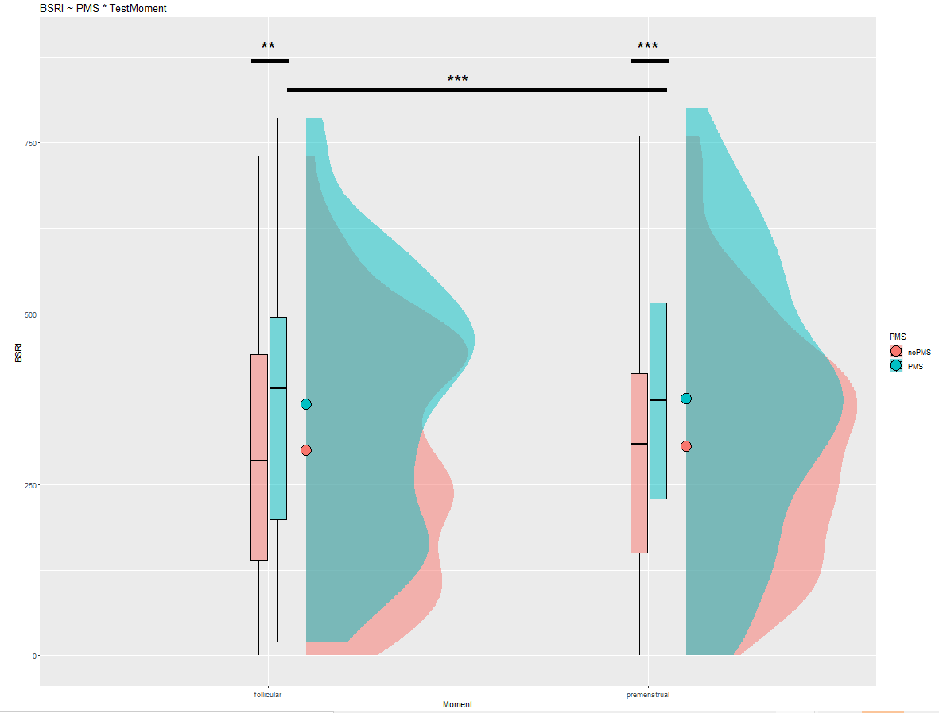
Notes:
Even when controlling for testmoment. And we can also see that, again, people with PMS have higher rumination during the premenstrual phase.

Slide 14
DASS

Slide 15
DASS
Depression, Anxiety, Stress
Trait, not state
Notes:
Then we looked at the DASS or Depression Anxiety Stress Scale. This is a trait measurement so we did not look at the effect of testmoment here, only at people with and without PMS.

Slide 16
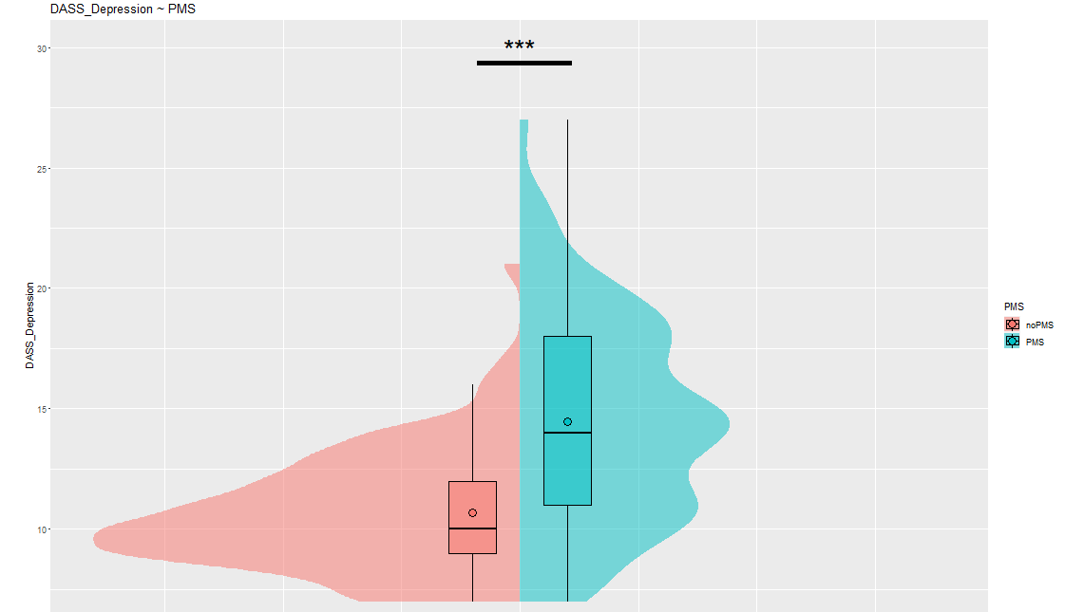
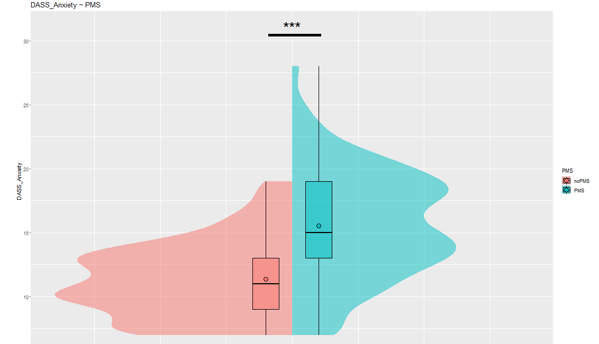
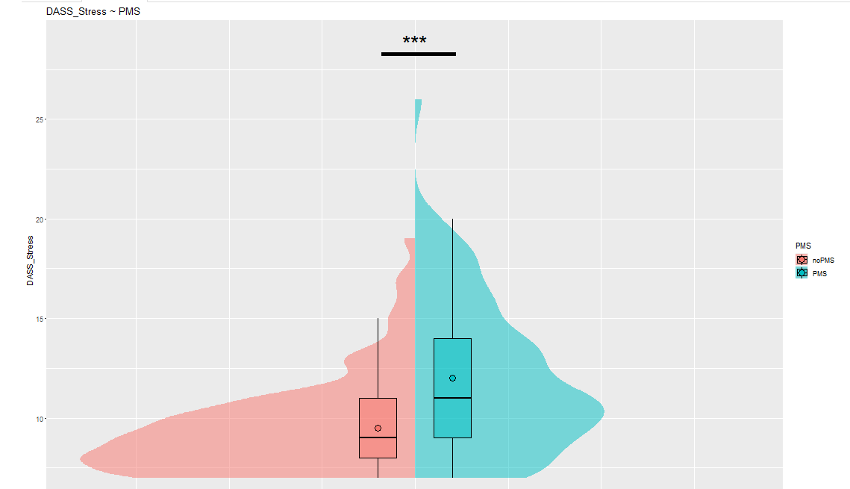
Notes:
Here, we see that people with PMS scored higher than people with low PMS scores on all 3 DASS Subscales.
Aggain, this is about a trait, not a state.

Slide 17
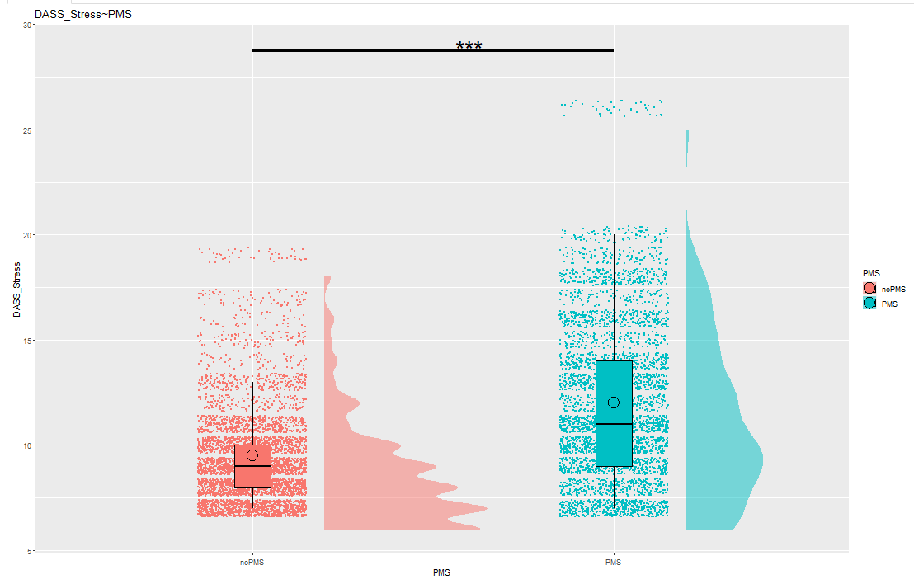
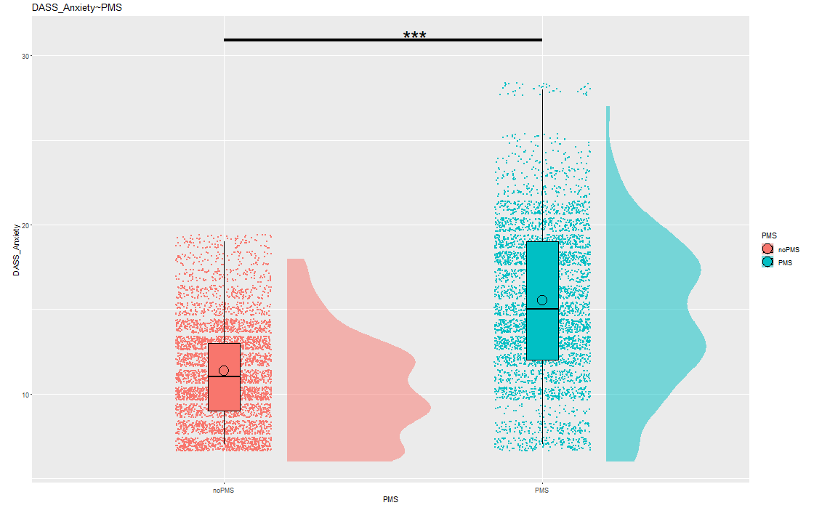
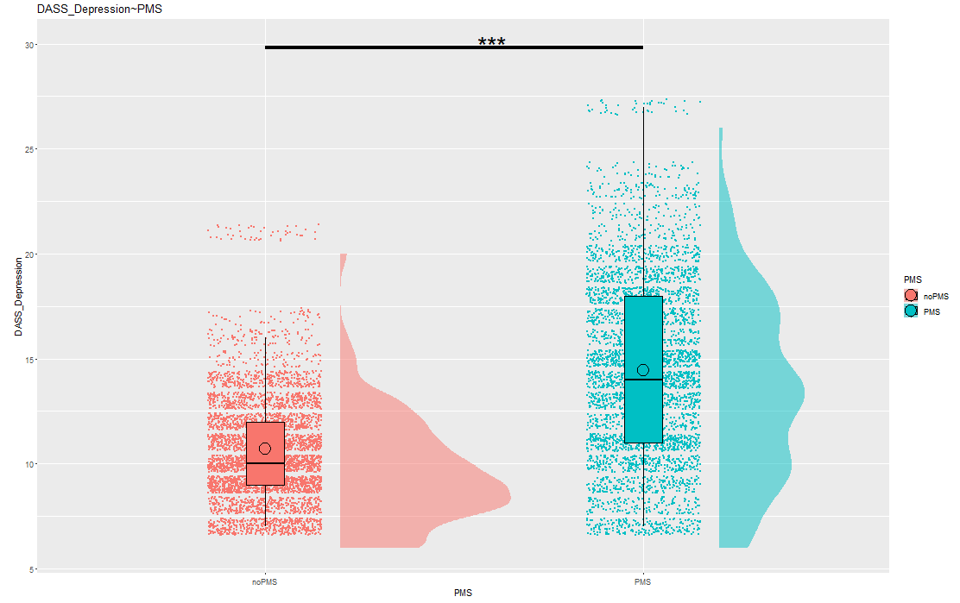

Slide 18
IAPs IMAGES
Notes:
Now, let’s look at the images the participants had to judge.

Slide 19
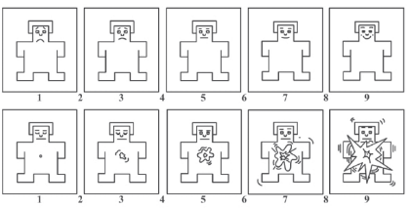
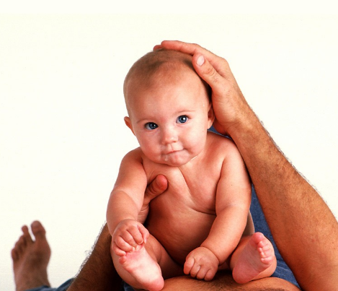
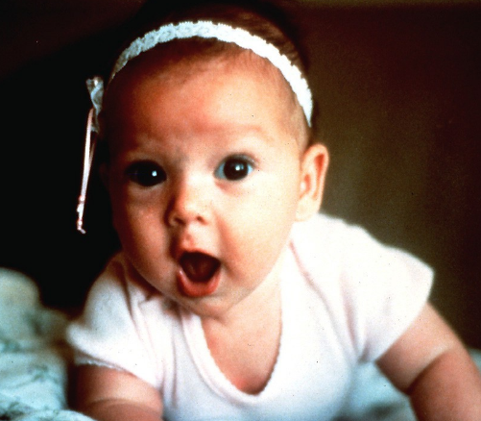
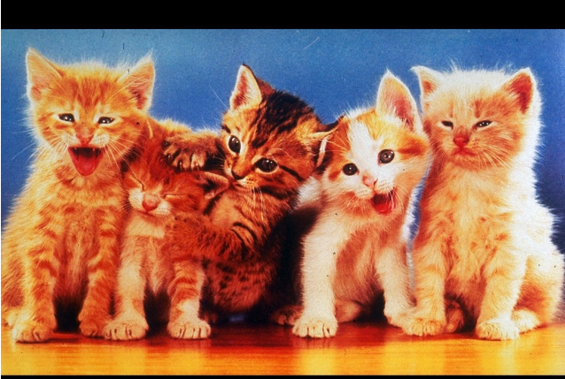
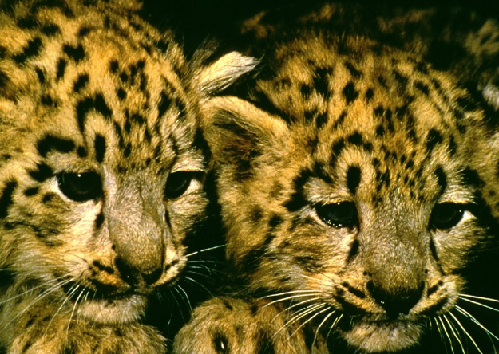
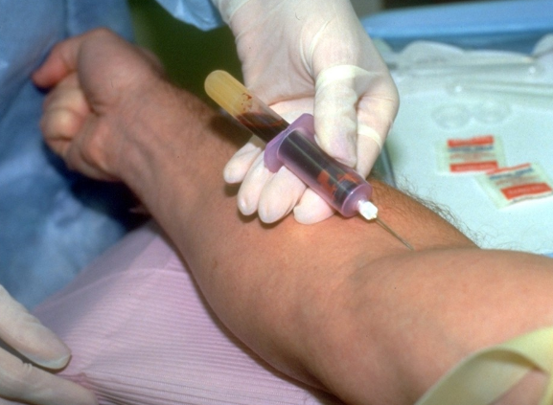
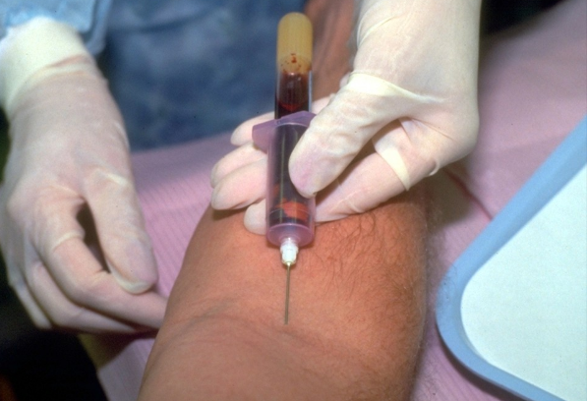
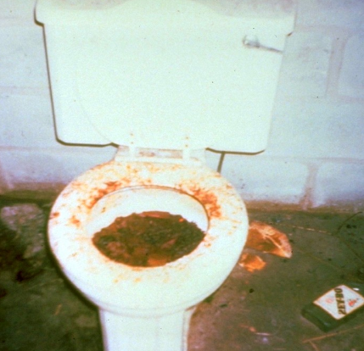
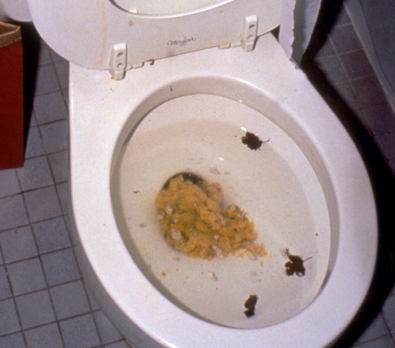
IAPs IMAGES
Valence and Arousal
- Counterbalanced: image group A and B
Notes:
These were IAPs images which is a dataset of images that has already been thoroughly scored in the past. Participants could indicate how the images scored for them on Valence (upper row) and arousal (second row). There were two image groups, A and B, that were counterbalanced. So each image group would have for example a puppy, a scary image etc. The order was also counterbalanced, meaning some participants got A on the first testmoment, some got B.

Slide 20
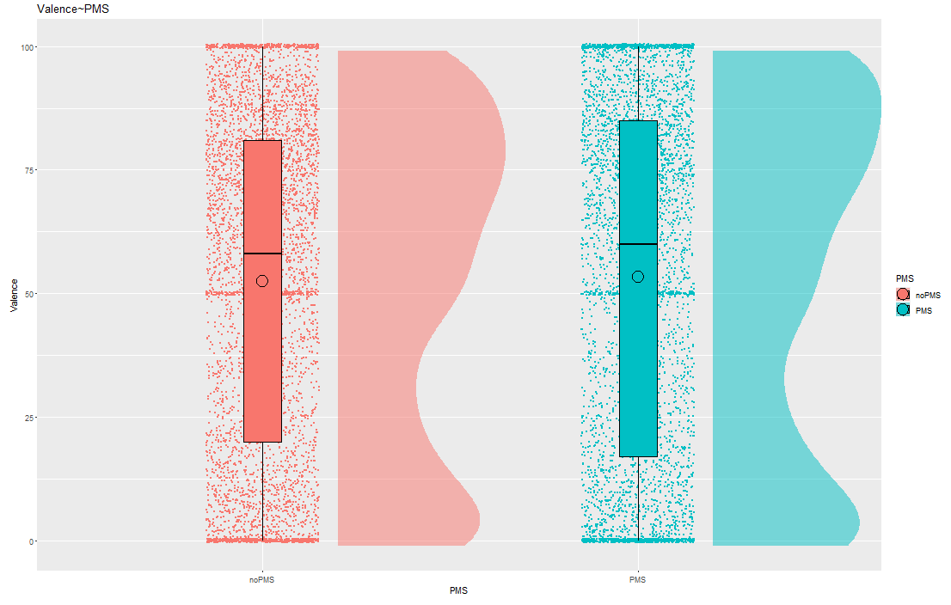
Valence
Notes:
We found that people with PMS rated the images higher on Arousal on average, but found no significant differences for Valence. When controlling for Testmoment we got the same results.

Slide 21
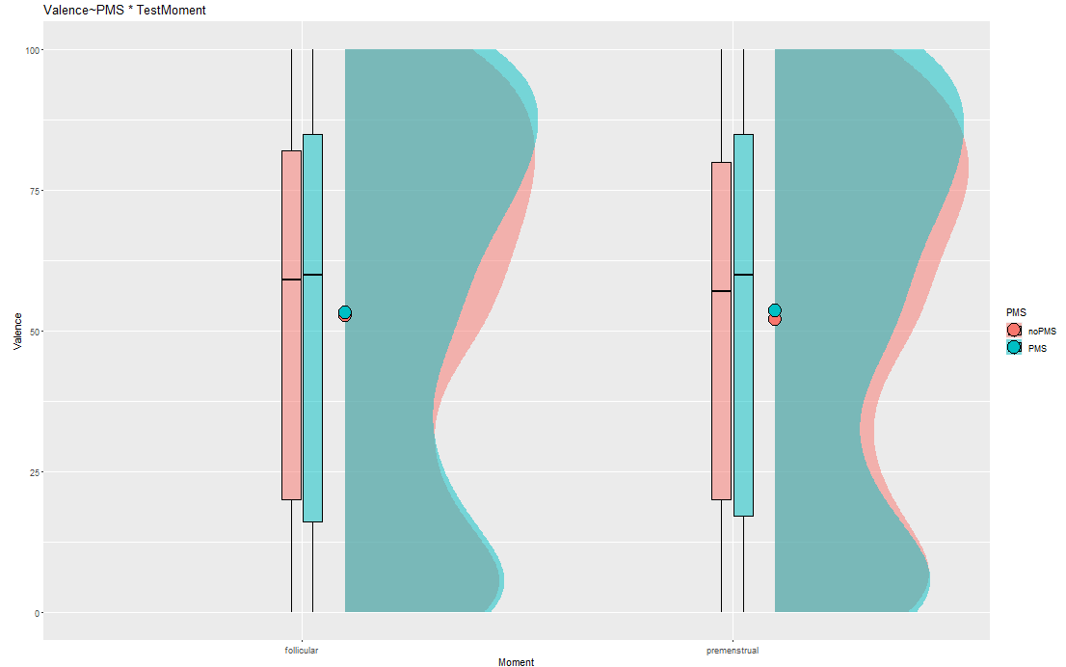

Slide 22
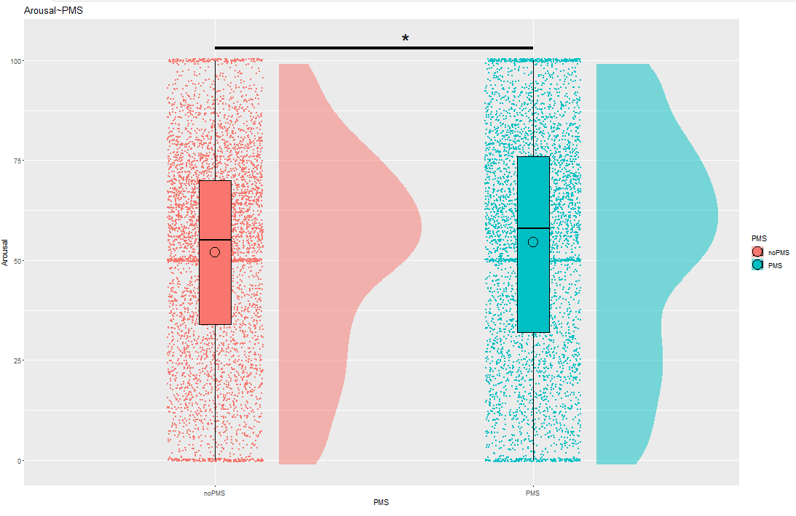
Arousal
PMS >
no PMS

Slide 23
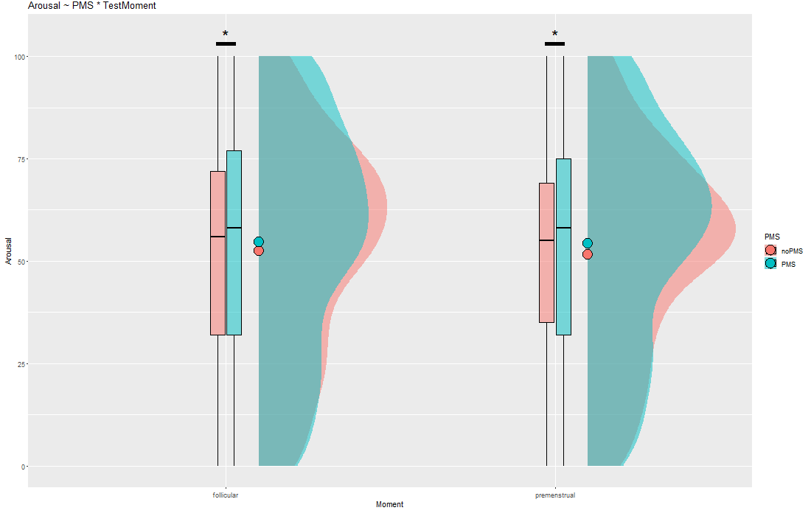
Notes:
We find the same when controlling for TestMoment. However, we did not find a significant difference of the Arousal levels between follicular and premenstrual

Slide 24
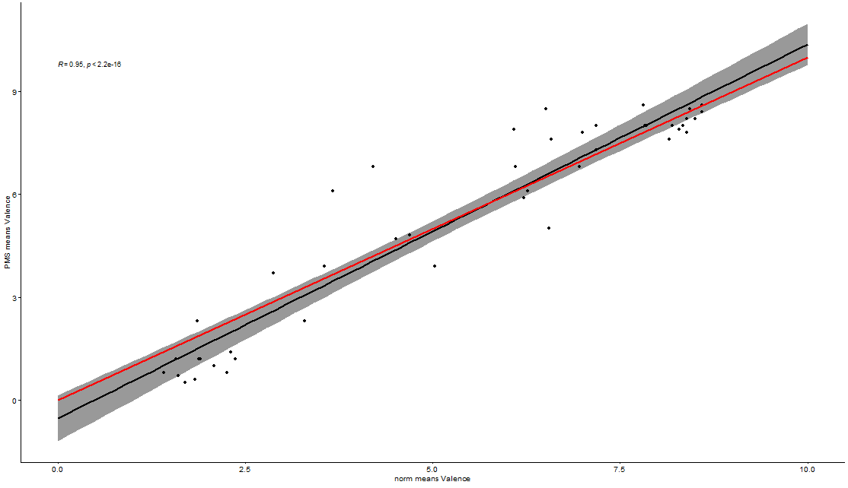
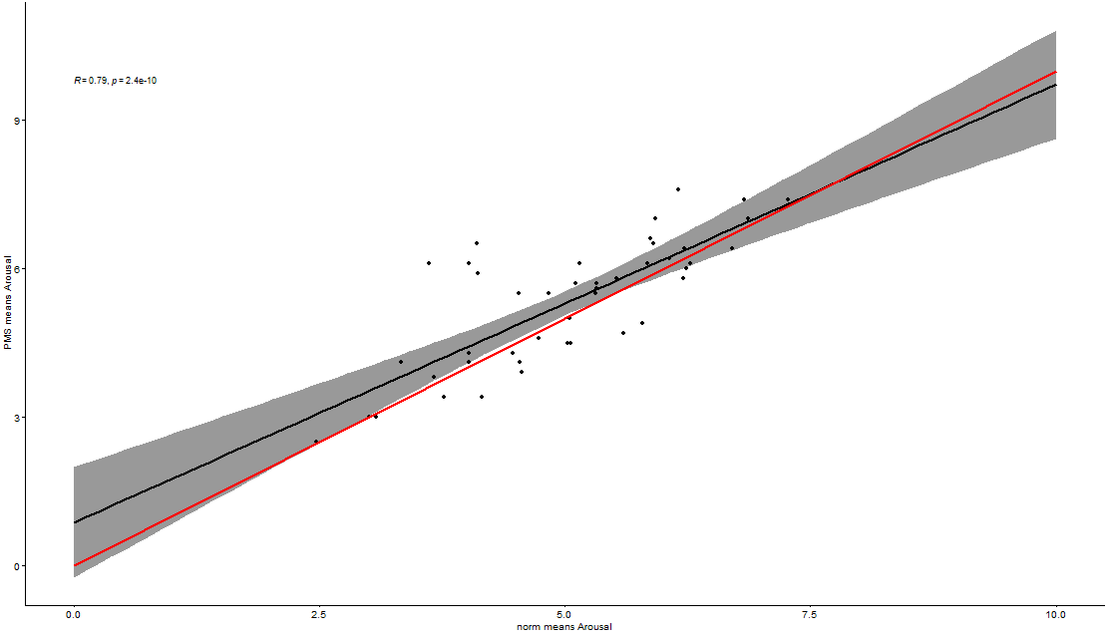
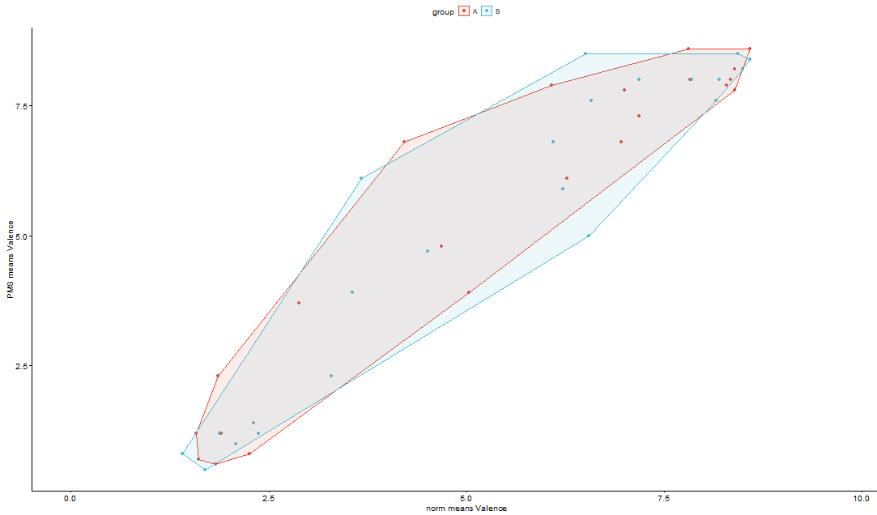
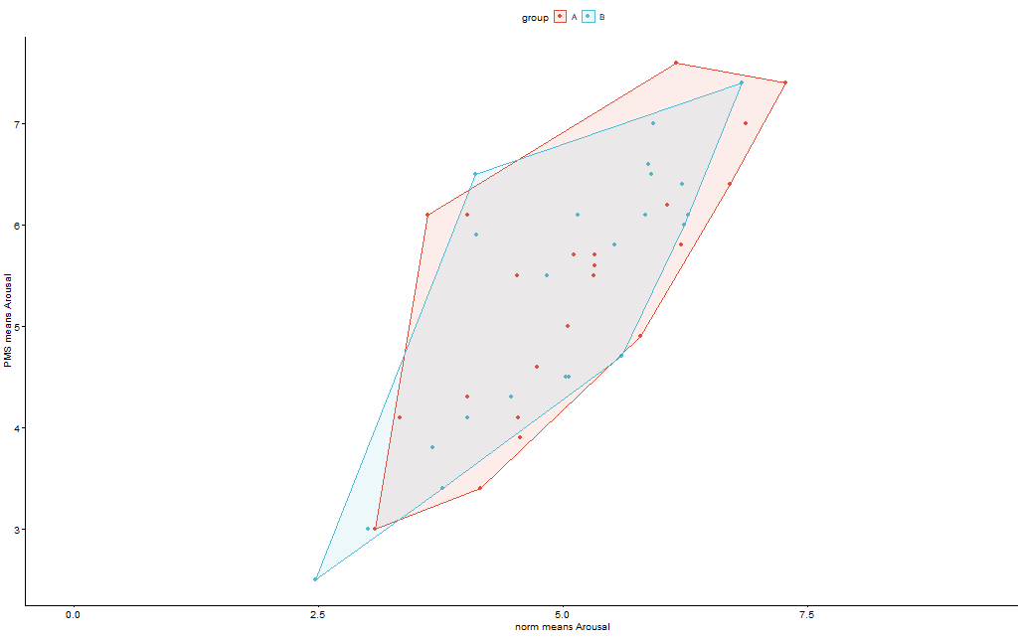
Notes:
We checked if there were differences between our study and the norms on these images in arousal and valence, and found high and significant correlations. We also did not find much differences between the image groups A and B.

Slide 25
Emotional Expressions

Slide 26
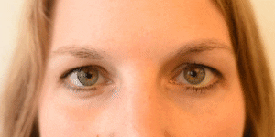
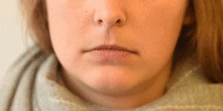
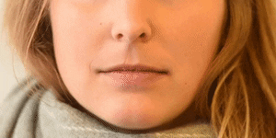
Facial Action Coding
Webcam would record participants as they judged the pictures
Gives us a measure that is not a form of self-report
corona proof!
Notes:
https://imotions.com/blog/facial-action-coding-system/

Slide 27




Sofie Raeymakers intern E sofie.raeymakersugent.be www.ugent.be
Universiteit Gent @ugent
@ugent Ghent University

